Slide 1
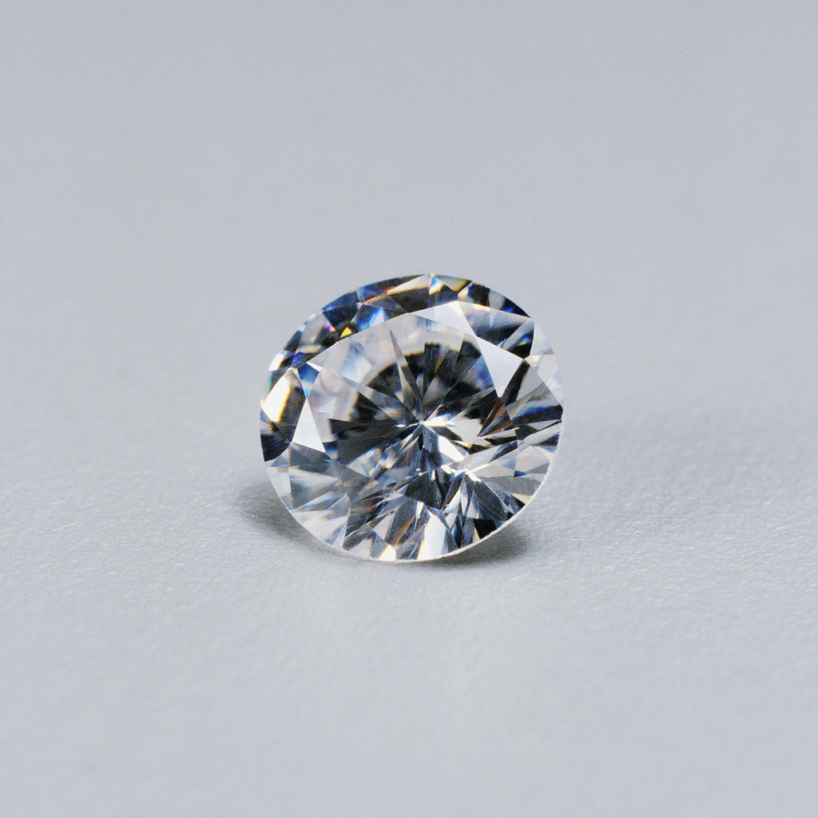
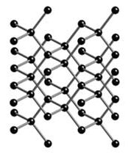
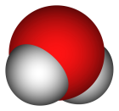
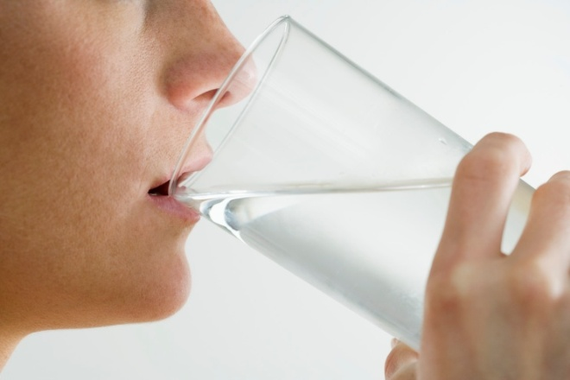
Atoms are the basic building blocks of
matter that make up everything around us.
Retrieved March 19, 2010,
from: http ://www.science.org.au/nova/024/024key.htm
Retrieved March 19, 2010,
from: http://www.globalwarmingart.com/wiki/File:Water_Molecule_VdW_png

Slide 2
There are many different types of atoms.
Like many things around us, atoms have characteristics like size and mass. However, it is noted that a larger atom may not necessarily have a larger mass.
 | Lithium | Oxygen | Sodium
Atomic Symbol | Li | O | Na
Relative Atomic Mass | 7 | 16 | 23
Atomic diameter ( X 10⁻¹⁰ metres) | 4.10 | 1.30 | 4.46
The different atoms discovered on Earth thus far are systematically arranged in the Periodic Table.

Slide 3
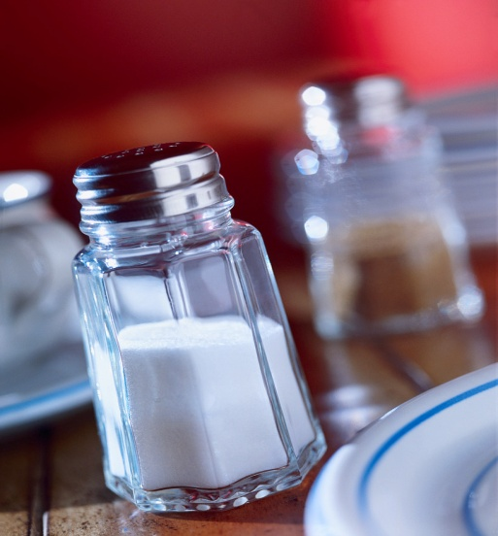
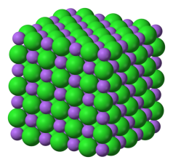
Certain atoms like argon can exist without combining with other atoms. They are found as gases made up of single atoms.
However, most atoms rarely exist on their own. They are commonly found combined with one or more atoms.
Retrieved March 19, 2010,
from: http://kimberlysnyder.net/2010/01/
Retrieved March 19, 2010,
from: http://www.webschool.org.uk/revision/ioniccompounds.htm

Slide 4
Your challenge for the day!
Determine how the components of an atom will affect:
  The atomic mass of an atom
  The size of an atom
  Using the Periodic Table, state and explain,
  The trends in atomic mass and size
  The ways which two or more atoms may combine together.

